Slide 1
Data Mining: 4. Algoritma Klasifikasi
Romi Satria Wahono romi@romisatriawahono.net http://romisatriawahono.net/dm WA/SMS: +6281586220090

Slide 2
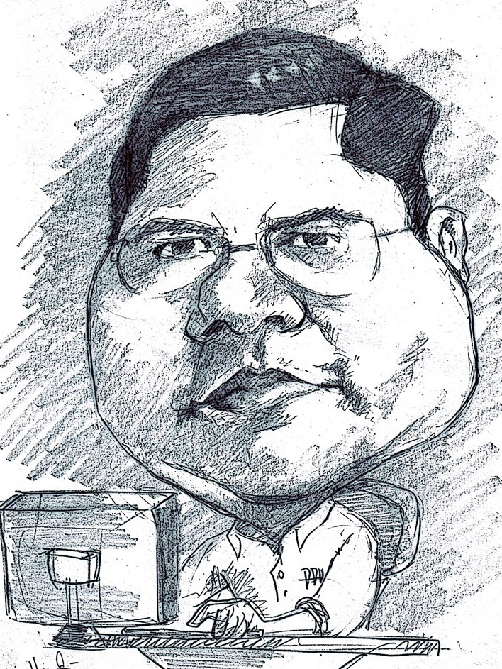
Romi Satria Wahono
SD Sompok Semarang (1987)
SMPN 8 Semarang (1990)
SMA Taruna Nusantara Magelang (1993)
B.Eng, M.Eng and Ph.D in Software Engineering from Saitama University Japan (1994-2004) Universiti Teknikal Malaysia Melaka (2014)
Research Interests: Software Engineering, Machine Learning
Founder dan Koordinator IlmuKomputer.Com
Peneliti LIPI (2004-2007)
Founder dan CEO PT Brainmatics Cipta Informatika

Slide 3
Course Outline
1. Pengantar Data Mining
3. Persiapan Data
4. Algoritma Klasifikasi
2. Proses Data Mining
5. Algoritma Klastering
7. Algoritma Estimasi dan Forecasting
6. Algoritma Asosiasi
8. Text Mining

Slide 4
4. Algoritma Klasifikasi
4.1 Decision Tree Induction
4.2 Bayesian Classification
4.3 Neural Network
4.4 Model Evaluation and Selection
4.5 Techniques to Improve Classification Accuracy: Ensemble Methods

Slide 5
4.1 Decision Tree

Slide 6
Algorithm for Decision Tree Induction
Basic algorithm (a greedy algorithm)
Tree is constructed in a top-down recursive divide-and-conquer manner
At start, all the training examples are at the root
Attributes are categorical (if continuous-valued, they are discretized in advance)
Examples are partitioned recursively based on selected attributes
Test attributes are selected on the basis of a heuristic or statistical measure (e.g., information gain, gain ratio, gini index)
Conditions for stopping partitioning
All samples for a given node belong to the same class
There are no remaining attributes for further partitioning – majority voting is employed for classifying the leaf
There are no samples left

Slide 7
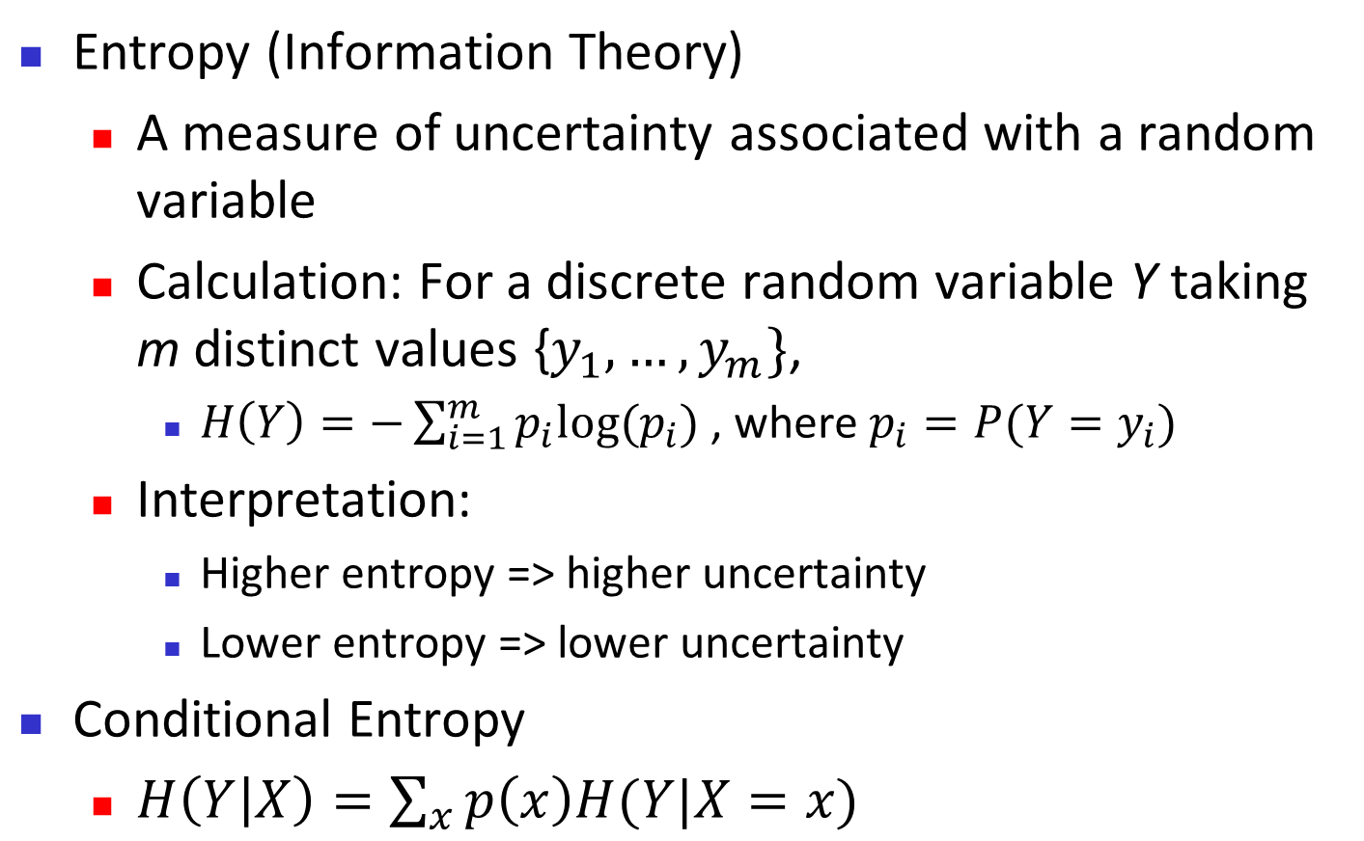
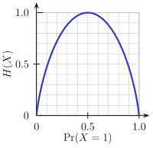
Brief Review of Entropy
m = 2

Slide 8
Attribute Selection Measure: Information Gain (ID3)
Select the attribute with the highest information gain
Let p_{i} be the probability that an arbitrary tuple in D belongs to class C_{i}, estimated by | C_{i}, D|/|D|
Expected information (entropy) needed to classify a tuple in D:
Information needed (after using A to split D into v partitions) to classify D:
Information gained by branching on attribute A

Slide 9
Attribute Selection: Information Gain
Class P: buys_computer = “yes”
Class N: buys_computer = “no”
means “age <=30” has 5 out of 14 samples, with 2 yes’es and 3 no’s. Hence
Similarly,

Slide 10
Computing Information-Gain for Continuous-Valued Attributes
Let attribute A be a continuous-valued attribute
Must determine the best split point for A
Sort the value A in increasing order
Typically, the midpoint between each pair of adjacent values is considered as a possible split point
(a_{i}+a_{i+1})/2 is the midpoint between the values of a_{i} and a_{i+1}
The point with the minimum expected information requirement for A is selected as the split-point for A
Split:
D₁ is the set of tuples in D satisfying A ≤ split-point, and D₂ is the set of tuples in D satisfying A > split-point

Slide 11
Tahapan Algoritma Decision Tree
Siapkan data training
Pilih atribut sebagai akar
Buat cabang untuk tiap-tiap nilai
Ulangi proses untuk setiap cabang sampai semua kasus pada cabang memiliki kelas yg sama

Slide 12
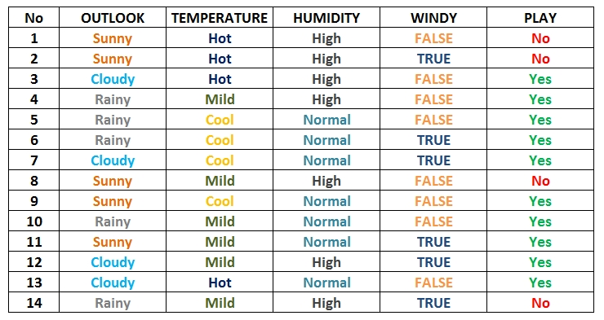
1. Siapkan data training

Slide 13
2. Pilih atribut sebagai akar
Untuk memilih atribut akar, didasarkan pada nilai Gain tertinggi dari atribut-atribut yang ada. Untuk mendapatkan nilai Gain, harus ditentukan terlebih dahulu nilai Entropy
Rumus Entropy:
S = Himpunan Kasus
n = Jumlah Partisi S
pi = Proporsi dari Si terhadap S
Rumus Gain:
S = Himpunan Kasus
A = Atribut
n = Jumlah Partisi Atribut A
| Si | = Jumlah Kasus pada partisi ke-i
| S | = Jumlah Kasus dalam S

Slide 14
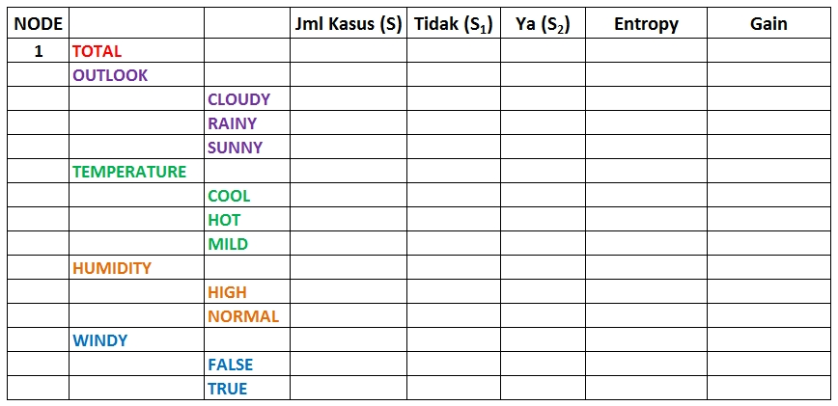
Perhitungan Entropy dan Gain Akar

Slide 15
Penghitungan Entropy Akar
Entropy Total
Entropy (Outlook)
Entropy (Temperature)
Entropy (Humidity)
Entropy (Windy)

Slide 16
Penghitungan Entropy Akar
NODE | ATRIBUT |  | JML KASUS (S) | YA (Si) | TIDAK (Si) | ENTROPY | GAIN
1 | TOTAL |  | 14 | 10 | 4 | 0,86312
 | OUTLOOK
 |  | CLOUDY | 4 | 4 | 0 | 0
 |  | RAINY | 5 | 4 | 1 | 0,72193
 |  | SUNNY | 5 | 2 | 3 | 0,97095
 | TEMPERATURE
 |  | COOL | 4 | 0 | 4 | 0
 |  | HOT | 4 | 2 | 2 | 1
 |  | MILD | 6 | 2 | 4 | 0,91830
 | HUMADITY
 |  | HIGH | 7 | 4 | 3 | 0,98523
 |  | NORMAL | 7 | 7 | 0 | 0
 | WINDY
 |  | FALSE | 8 | 2 | 6 | 0,81128
 |  | TRUE | 6 | 4 | 2 | 0,91830

Slide 17
Penghitungan Gain Akar

Slide 18
Penghitungan Gain Akar
NODE | ATRIBUT |  | JML KASUS (S) | YA (Si) | TIDAK (Si) | ENTROPY | GAIN
1 | TOTAL |  | 14 | 10 | 4 | 0,86312
 | OUTLOOK |  |  |  |  |  | 0,25852
 |  | CLOUDY | 4 | 4 | 0 | 0
 |  | RAINY | 5 | 4 | 1 | 0,72193
 |  | SUNNY | 5 | 2 | 3 | 0,97095
 | TEMPERATURE |  |  |  |  |  | 0,18385
 |  | COOL | 4 | 0 | 4 | 0
 |  | HOT | 4 | 2 | 2 | 1
 |  | MILD | 6 | 2 | 4 | 0,91830
 | HUMADITY |  |  |  |  |  | 0,37051
 |  | HIGH | 7 | 4 | 3 | 0,98523
 |  | NORMAL | 7 | 7 | 0 | 0
 | WINDY |  |  |  |  |  | 0,00598
 |  | FALSE | 8 | 2 | 6 | 0,81128
 |  | TRUE | 6 | 4 | 2 | 0,91830

Slide 19
Gain Tertinggi Sebagai Akar
Dari hasil pada Node 1, dapat diketahui bahwa atribut dengan Gain tertinggi adalah HUMIDITY yaitu sebesar 0.37051
Dengan demikian HUMIDITY dapat menjadi node akar
Ada 2 nilai atribut dari HUMIDITY yaitu HIGH dan NORMAL. Dari kedua nilai atribut tersebut, nilai atribut NORMAL sudah mengklasifikasikan kasus menjadi 1 yaitu keputusan-nya Yes, sehingga tidak perlu dilakukan perhitungan lebih lanjut
Tetapi untuk nilai atribut HIGH masih perlu dilakukan perhitungan lagi
1. HUMIDITY
High
Normal
1.1
?????
Yes

Slide 20
2. Buat cabang untuk tiap-tiap nilai
Untuk memudahkan, dataset di filter dengan mengambil data yang memiliki kelembaban HUMADITY=HIGH untuk membuat table Node 1.1
OUTLOOK | TEMPERATURE | HUMIDITY | WINDY | PLAY
Sunny | Hot | High | FALSE | No
Sunny | Hot | High | TRUE | No
Cloudy | Hot | High | FALSE | Yes
Rainy | Mild | High | FALSE | Yes
Sunny | Mild | High | FALSE | No
Cloudy | Mild | High | TRUE | Yes
Rainy | Mild | High | TRUE | No

Slide 21
Perhitungan Entropi Dan Gain Cabang
NODE | ATRIBUT |  | JML KASUS (S) | YA (Si) | TIDAK (Si) | ENTROPY | GAIN
1.1 | HUMADITY |  | 7 | 3 | 4 | 0,98523
 | OUTLOOK |  |  |  |  |  | 0,69951
 |  | CLOUDY | 2 | 2 | 0 | 0
 |  | RAINY | 2 | 1 | 1 | 1
 |  | SUNNY | 3 | 0 | 3 | 0
 | TEMPERATURE |  |  |  |  |  | 0,02024
 |  | COOL | 0 | 0 | 0 | 0
 |  | HOT | 3 | 1 | 2 | 0,91830
 |  | MILD | 4 | 2 | 2 | 1
 | WINDY |  |  |  |  |  | 0,02024
 |  | FALSE | 4 | 2 | 2 | 1
 |  | TRUE | 3 | 1 | 2 | 0,91830

Slide 22
Gain Tertinggi Sebagai Node 1.1
Dari hasil pada Tabel Node 1.1, dapat diketahui bahwa atribut dengan Gain tertinggi adalah OUTLOOK yaitu sebesar 0.69951
Dengan demikian OUTLOOK dapat menjadi node kedua
Artibut CLOUDY = YES dan SUNNY= NO sudah mengklasifikasikan kasus menjadi 1 keputusan, sehingga tidak perlu dilakukan perhitungan lebih lanjut
Tetapi untuk nilai atribut RAINY masih perlu dilakukan perhitungan lagi
1. HUMIDITY
High
Normal
1.1
OUTLOOK
Yes
Cloudy
Sunny
Rainy
Yes
1.1.2
?????
No

Slide 23
3. Ulangi proses untuk setiap cabang sampai semua kasus pada cabang memiliki kelas yg sama
OUTLOOK | TEMPERATURE | HUMIDITY | WINDY | PLAY
Rainy | Mild | High | FALSE | Yes
Rainy | Mild | High | TRUE | No
NODE | ATRIBUT |  | JML KASUS (S) | YA (Si) | TIDAK (Si) | ENTROPY | GAIN
1.2 | HUMADITY HIGH & OUTLOOK RAINY |  | 2 | 1 | 1 | 1
 | TEMPERATURE |  |  |  |  |  | 0
 |  | COOL | 0 | 0 | 0 | 0
 |  | HOT | 0 | 0 | 0 | 0
 |  | MILD | 2 | 1 | 1 | 1
 | WINDY |  |  |  |  |  | 1
 |  | FALSE | 1 | 1 | 0 | 0
 |  | TRUE | 1 | 0 | 1 | 0

Slide 24
Gain Tertinggi Sebagai Node 1.1.2
1. HUMIDITY
Dari tabel, Gain Tertinggi adalah WINDY dan menjadi node cabang dari atribut RAINY
Karena semua kasus sudah masuk dalam kelas
Jadi, pohon keputusan pada Gambar merupakan pohon keputusan terakhir yang terbentuk
High
Normal
1.1
OUTLOOK
Yes
Cloudy
Rainy
Sunny
Yes
1.1.2
WINDY
No
False
True
Yes
No

Slide 25
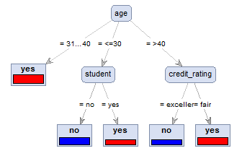
Decision Tree Induction: An Example
age | income | student | credit_rating | buys_computer
<=30 | high | no | fair | no
<=30 | high | no | excellent | no
31…40 | high | no | fair | yes
>40 | medium | no | fair | yes
>40 | low | yes | fair | yes
>40 | low | yes | excellent | no
31…40 | low | yes | excellent | yes
<=30 | medium | no | fair | no
<=30 | low | yes | fair | yes
>40 | medium | yes | fair | yes
<=30 | medium | yes | excellent | yes
31…40 | medium | no | excellent | yes
31…40 | high | yes | fair | yes
>40 | medium | no | excellent | no
Training data set: Buys_computer

Slide 26
Gain Ratio for Attribute Selection (C4.5)
Information gain measure is biased towards attributes with a large number of values
C4.5 (a successor of ID3) uses gain ratio to overcome the problem (normalization to information gain)
GainRatio(A) = Gain(A)/SplitInfo(A)
Ex.
gain_ratio(income) = 0.029/1.557 = 0.019
The attribute with the maximum gain ratio is selected as the splitting attribute

Slide 27
Gini Index (CART)
If a data set D contains examples from n classes, gini index, gini(D) is defined as
where p_{j} is the relative frequency of class j in D
If a data set D is split on A into two subsets D₁ and D₂, the gini index gini(D) is defined as
Reduction in Impurity:
The attribute provides the smallest gini_{split}(D) (or the largest reduction in impurity) is chosen to split the node (need to enumerate all the possible splitting points for each attribute)

Slide 28
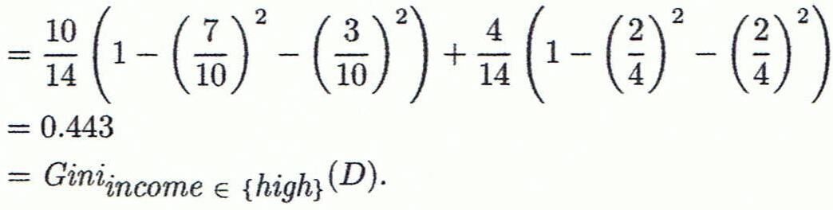
Computation of Gini Index
Ex. D has 9 tuples in buys_computer = “yes” and 5 in “no”
Suppose the attribute income partitions D into 10 in D₁: {low, medium} and 4 in D₂
Gini_{{low,high}} is 0.458; Gini_{{medium,high}} is 0.450. Thus, split on the {low,medium} (and {high}) since it has the lowest Gini index
All attributes are assumed continuous-valued
May need other tools, e.g., clustering, to get the possible split values
Can be modified for categorical attributes

Slide 29
Comparing Attribute Selection Measures
The three measures, in general, return good results but
Information gain:
biased towards multivalued attributes
Gain ratio:
tends to prefer unbalanced splits in which one partition is much smaller than the others
Gini index:
biased to multivalued attributes
has difficulty when # of classes is large
tends to favor tests that result in equal-sized partitions and purity in both partitions

Slide 30
Other Attribute Selection Measures
CHAID: a popular decision tree algorithm, measure based on χ² test for independence
C-SEP: performs better than info. gain and gini index in certain cases
G-statistic: has a close approximation to χ² distribution
MDL (Minimal Description Length) principle (i.e., the simplest solution is preferred):
The best tree as the one that requires the fewest # of bits to both (1) encode the tree, and (2) encode the exceptions to the tree
Multivariate splits (partition based on multiple variable combinations)
CART: finds multivariate splits based on a linear comb. of attrs.
Which attribute selection measure is the best?
Most give good results, none is significantly superior than others

Slide 31
Overfitting and Tree Pruning
Overfitting: An induced tree may overfit the training data
Too many branches, some may reflect anomalies due to noise or outliers
Poor accuracy for unseen samples
Two approaches to avoid overfitting
Prepruning: Halt tree construction early ̵ do not split a node if this would result in the goodness measure falling below a threshold
Difficult to choose an appropriate threshold
Postpruning: Remove branches from a “fully grown” tree -get a sequence of progressively pruned trees
Use a set of data different from the training data to decide which is the “best pruned tree”

Slide 32
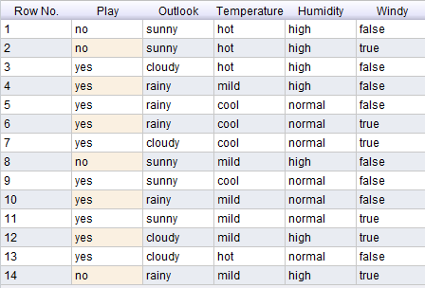
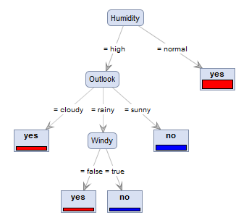
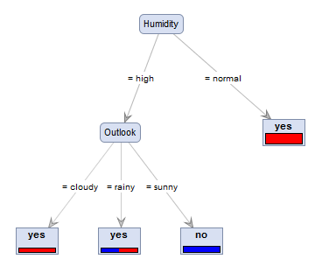
Pruning

Slide 33
Why is decision tree induction popular?
Relatively faster learning speed (than other classification methods)
Convertible to simple and easy to understand classification rules
Can use SQL queries for accessing databases
Comparable classification accuracy with other methods

Slide 34
Latihan
Lakukan eksperimen mengikuti buku Matthew North (Data Mining for the Masses) Chapter 10 (Decision Tree), p 157-174
Datasets: eReader-Training.csv dan eReader-Scoring.csv
Analisis jenis decision tree apa saja yang digunakan dan mengapa perlu dilakukan pada dataset tersebut

Slide 35
4.2 Bayesian Classification

Slide 36
Bayesian Classification: Why?
A statistical classifier: performs probabilistic prediction, i.e., predicts class membership probabilities
Foundation: Based on Bayes’ Theorem.
Performance: A simple Bayesian classifier, naïve Bayesian classifier, has comparable performance with decision tree and selected neural network classifiers
Incremental: Each training example can incrementally increase/decrease the probability that a hypothesis is correct — prior knowledge can be combined with observed data
Standard: Even when Bayesian methods are computationally intractable, they can provide a standard of optimal decision making against which other methods can be measured

Slide 37
Bayes’ Theorem: Basics
Total probability Theorem:
Bayes’ Theorem:
Let X be a data sample (“evidence”): class label is unknown
Let H be a hypothesis that X belongs to class C
Classification is to determine P(H|X), (i.e., posteriori probability): the probability that the hypothesis holds given the observed data sample X
P(H) (prior probability): the initial probability
E.g., X will buy computer, regardless of age, income, …
P(X): probability that sample data is observed
P(X|H) (likelihood): the probability of observing the sample X, given that the hypothesis holds
E.g., Given that X will buy computer, the prob. that X is 31..40, medium income

Slide 38
Prediction Based on Bayes’ Theorem
Given training data X, posteriori probability of a hypothesis H, P(H|X), follows the Bayes’ theorem
Informally, this can be viewed as
posteriori = likelihood x prior/evidence
Predicts X belongs to C_{i} iff the probability P(C_{i}|X) is the highest among all the P(C_{k}|X) for all the k classes
Practical difficulty: It requires initial knowledge of many probabilities, involving significant computational cost

Slide 39
Classification is to Derive the Maximum Posteriori
Let D be a training set of tuples and their associated class labels, and each tuple is represented by an n-D attribute vector X = (x₁, x₂, …, x_{n})
Suppose there are m classes C₁, C₂, …, C_{m}.
Classification is to derive the maximum posteriori, i.e., the maximal P(C_{i}|X)
This can be derived from Bayes’ theorem
Since P(X) is constant for all classes, only
needs to be maximized

Slide 40
Naïve Bayes Classifier
A simplified assumption: attributes are conditionally independent (i.e., no dependence relation between attributes):
This greatly reduces the computation cost: Only counts the class distribution
If A_{k} is categorical, P(x_{k}|C_{i}) is the # of tuples in C_{i} having value x_{k} for A_{k} divided by |C_{i, D}| (# of tuples of C_{i} in D)
If A_{k} is continous-valued, P(x_{k}|C_{i}) is usually computed based on Gaussian distribution with a mean μ and standard deviation σ
and P(x_{k}|C_{i}) is

Slide 41
Naïve Bayes Classifier: Training Dataset
age | income | student | credit_rating | buys_computer
<=30 | high | no | fair | no
<=30 | high | no | excellent | no
31…40 | high | no | fair | yes
>40 | medium | no | fair | yes
>40 | low | yes | fair | yes
>40 | low | yes | excellent | no
31…40 | low | yes | excellent | yes
<=30 | medium | no | fair | no
<=30 | low | yes | fair | yes
>40 | medium | yes | fair | yes
<=30 | medium | yes | excellent | yes
31…40 | medium | No | excellent | yes
31…40 | high | Yes | fair | yes
>40 | medium | No | excellent | no
Class:
C₁:buys_computer = ‘yes’
C₂:buys_computer = ‘no’
Data to be classified:
X = (age <=30,
income = medium,
student = yes,
credit_rating = fair)
X → buy computer?

Slide 42
Naïve Bayes Classifier: An Example
age | income | student | credit_rating | buys_computer
<=30 | high | no | fair | no
<=30 | high | no | excellent | no
31…40 | high | no | fair | yes
>40 | medium | no | fair | yes
>40 | low | yes | fair | yes
>40 | low | yes | excellent | no
31…40 | low | yes | excellent | yes
<=30 | medium | no | fair | no
<=30 | low | yes | fair | yes
>40 | medium | yes | fair | yes
<=30 | medium | yes | excellent | yes
31…40 | medium | no | excellent | yes
31…40 | high | yes | fair | yes
>40 | medium | no | excellent | no
P(C_{i}): P(buys_computer = “yes”) = 9/14 = 0.643
P(buys_computer = “no”) = 5/14= 0.357
Compute P(X|C_{i}) for each class
P(age = “<=30” | buys_computer = “yes”) = 2/9 = 0.222
P(age = “<= 30” | buys_computer = “no”) = 3/5 = 0.6
P(income = “medium” | buys_computer = “yes”) = 4/9 = 0.444
P(income = “medium” | buys_computer = “no”) = 2/5 = 0.4
P(student = “yes” | buys_computer = “yes) = 6/9 = 0.667
P(student = “yes” | buys_computer = “no”) = 1/5 = 0.2
P(credit_rating = “fair” | buys_computer = “yes”) = 6/9 = 0.667
P(credit_rating = “fair” | buys_computer = “no”) = 2/5 = 0.4
X = (age <= 30 , income = medium, student = yes, credit_rating = fair)
P(X|C_{i}) : P(X|buys_computer = “yes”) = 0.222 x 0.444 x 0.667 x 0.667 = 0.044
P(X|buys_computer = “no”) = 0.6 x 0.4 x 0.2 x 0.4 = 0.019
P(X|C_{i})*P(C_{i}) : P(X|buys_computer = “yes”) * P(buys_computer = “yes”) = 0.028
P(X|buys_computer = “no”) * P(buys_computer = “no”) = 0.007
Therefore, X belongs to class (“buys_computer = yes”)

Slide 43
Tahapan Algoritma Naïve Bayes
Baca Data Training
Hitung jumlah class
Hitung jumlah kasus yang sama dengan class yang sama
Kalikan semua nilai hasil sesuai dengan data X yang dicari class-nya

Slide 44
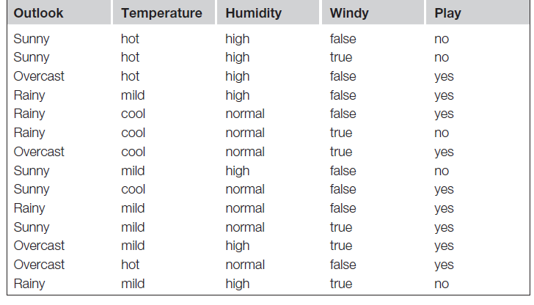
1. Baca Data Training

Slide 45
Teorema Bayes
X → Data dengan class yang belum diketahui
H → Hipotesis data X yang merupakan suatu class yang lebih spesifik
P (H|X) → Probabilitas hipotesis H berdasarkan kondisi X (posteriori probability)
P (H) → Probabilitas hipotesis H (prior probability)
P (X|H) → Probabilitas X berdasarkan kondisi pada hipotesis H
P (X) → Probabilitas X

Slide 46
2. Hitung jumlah class/label
Terdapat 2 class dari data training tersebut, yaitu:
C1 (Class 1) →Play = yes → 9 record
C2 (Class 2) →Play = no → 5 record
Total = 14 record
Maka:
P (C1) = 9/14 = 0.642857143
P (C2) = 5/14 = 0.357142857
Pertanyaan:
Data X = (outlook=rainy, temperature=cool, humidity=high, windy=true)
Main golf atau tidak?

Slide 47
3. Hitung jumlah kasus yang sama dengan class yang sama
Untuk P(Ci) yaitu P(C1) dan P(C2) sudah diketahui hasilnya di langkah sebelumnya.
Selanjutnya Hitung P(X|Ci) untuk i = 1 dan 2
P(outlook=“sunny”|play=“yes”)=2/9=0.222222222
P(outlook=“sunny”|play=“no”)=3/5=0.6
P(outlook=“overcast”|play=“yes”)=4/9=0.444444444
P(outlook=“overcast”|play=“no”)=0/5=0
P(outlook=“rainy”|play=“yes”)=3/9=0.333333333
P(outlook=“rainy”|play=“no”)=2/5=0.4

Slide 48
3. Hitung jumlah kasus yang sama dengan class yang sama
Jika semua atribut dihitung, maka didapat hasil akhirnya seperti berikut ini:
Atribute | Parameter | No | Yes
Outlook | value=sunny | 0.6 | 0.2222222222222222
Outlook | value=cloudy | 0.0 | 0.4444444444444444
Outlook | value=rainy | 0.4 | 0.3333333333333333
Temperature | value=hot | 0.4 | 0.2222222222222222
Temperature | value=mild | 0.4 | 0.4444444444444444
Temperature | value=cool | 0.2 | 0.3333333333333333
Humidity | value=high | 0.8 | 0.3333333333333333
Humidity | value=normal | 0.2 | 0.6666666666666666
Windy | value=false | 0.4 | 0.6666666666666666
Windy | value=true | 0.6 | 0.3333333333333333

Slide 49
4. Kalikan semua nilai hasil sesuai dengan data X yang dicari class-nya
Pertanyaan:
Data X = (outlook=rainy, temperature=cool, humidity=high, windy=true)
Main Golf atau tidak?
Kalikan semua nilai hasil dari data X
P(X|play=“yes”) = 0.333333333* 0.333333333* 0.333333333*0.333333333 = 0.012345679
P(X|play=“no”) = 0.4*0.2*0.8*0.6=0.0384
P(X|play=“yes”)*P(C1) = 0.012345679*0.642857143
= 0.007936508
P(X|play=“no”)*P(C2) = 0.0384*0.357142857
= 0.013714286
Nilai “no” lebih besar dari nilai “yes” maka class dari data X tersebut adalah “No”

Slide 50
Avoiding the Zero-Probability Problem
Naïve Bayesian prediction requires each conditional prob. be non-zero. Otherwise, the predicted prob. will be zero
Ex. Suppose a dataset with 1000 tuples, income=low (0), income= medium (990), and income = high (10)
Use Laplacian correction (or Laplacian estimator)
Adding 1 to each case
Prob(income = low) = 1/1003
Prob(income = medium) = 991/1003
Prob(income = high) = 11/1003
The “corrected” prob. estimates are close to their “uncorrected” counterparts

Slide 51
Naïve Bayes Classifier: Comments
Advantages
Easy to implement
Good results obtained in most of the cases
Disadvantages
Assumption: class conditional independence, therefore loss of accuracy
Practically, dependencies exist among variables, e.g.:
Hospitals Patients Profile: age, family history, etc.
Symptoms: fever, cough etc.,
Disease: lung cancer, diabetes, etc.
Dependencies among these cannot be modeled by Naïve Bayes Classifier
How to deal with these dependencies? Bayesian Belief Networks

Slide 52
4.3 Neural Network

Slide 53
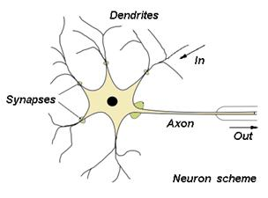
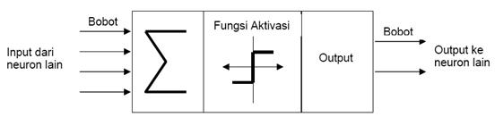
Neural Network
Neural Network adalah suatu model yang dibuat untuk meniru fungsi belajar yang dimiliki otak manusia atau jaringan dari sekelompok unit pemroses kecil yang dimodelkan berdasarkan jaringan saraf manusia

Slide 54
Neural Network
Model Perceptron adalah model jaringan yang terdiri dari beberapa unit masukan (ditambah dengan sebuah bias), dan memiliki sebuah unit keluaran
Fungsi aktivasi bukan hanya merupakan fungsi biner (0,1) melainkan bipolar (1,0,-1)
Untuk suatu harga threshold ѳ yang ditentukan:
1 Jika net > ѳ
F (net) = 0 Jika – ѳ ≤ net ≤ ѳ
-1 Jika net < - ѳ

Slide 55
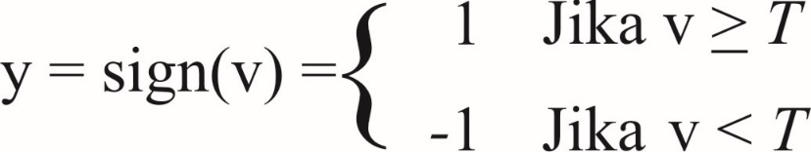
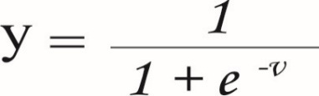
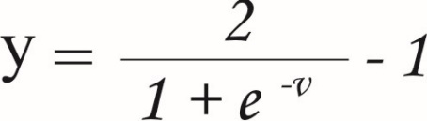
Fungsi Aktivasi
Macam fungsi aktivasi yang dipakai untuk mengaktifkan net diberbagai jenis neural network:
Aktivasi linear, Rumus: y = sign(v) = v
Aktivasi step, Rumus:
Aktivasi sigmoid biner, Rumus:
Aktivasi sigmoid bipolar, Rumus:

Slide 56

Tahapan Algoritma Perceptron
Inisialisasi semua bobot dan bias (umumnya wi = b = 0)
Selama ada element vektor masukan yang respon unit keluarannya tidak sama dengan target, lakukan:
2.1 Set aktivasi unit masukan xi = Si (i = 1,...,n)
2.2 Hitung respon unit keluaran: net = + b
1 Jika net > ѳ
F (net) = 0 Jika – ѳ ≤ net ≤ ѳ
-1 Jika net < - ѳ
2.3 Perbaiki bobot pola yang mengadung kesalahan menurut persamaan: Wi (baru) = wi (lama) + ∆w (i = 1,...,n) dengan ∆w = α t xi B (baru) = b(lama) + ∆ b dengan ∆b = α t Dimana: α = Laju pembelajaran (Learning rate) yang ditentukan ѳ = Threshold yang ditentukan t = Target
2.4 Ulangi iterasi sampai perubahan bobot (∆wn = 0) tidak ada

Slide 57
Studi Kasus
Diketahui sebuah dataset kelulusan berdasarkan IPK untuk program S1:
Jika ada mahasiswa IPK 2.85 dan masih semester 1, maka masuk ke kedalam manakah status tersebut ?
Status | IPK | Semester
Lulus | 2.9 | 1
Tidak Lulus | 2.8 | 3
Tidak Lulus | 2.3 | 5
Tidak lulus | 2.7 | 6

Slide 58
1: Inisialisasi Bobot
Inisialisasi Bobot dan bias awal: b = 0 dan bias = 1
t | X1 | X2
1 | 2,9 | 1
-1 | 2.8 | 3
-1 | 2.3 | 5
-1 | 2,7 | 6

Slide 59
2.1: Set aktivasi unit masukan
Treshold (batasan), θ = 0 , yang artinya :
1 Jika net > 0
F (net) = 0 Jika net = 0
-1 Jika net < 0

Slide 60
2.2 - 2.3 Hitung Respon dan Perbaiki Bobot
Hitung Response Keluaran iterasi 1
Perbaiki bobot pola yang mengandung kesalahan
MASUKAN |  |  | TARGET |  | y= | PERUBAHAN BOBOT |  |  | BOBOT BARU
X1 | X2 | 1 | t | NET | f(NET) | ∆W1 | ∆W2 | ∆b | W1 | W2 | b
INISIALISASI |  |  |  |  |  |  |  |  | 0 | 0 | 0
2,9 | 1 | 1 | 1 | 0 | 0 | 2,9 | 1 | 1 | 2,9 | 7 | 1
2,8 | 3 | 1 | -1 | 8,12 | 1 | -2,8 | -3 | -1 | 0,1 | 4 | 0
2,3 | 5 | 1 | -1 | 0,23 | 1 | -2,3 | -5 | -1 | -2,2 | -1 | -1
2,7 | 6 | 1 | -1 | -5,94 | -1 | 0 | 0 | 0 | -2,2 | -1 | -1

Slide 61
2.4 Ulangi iterasi sampai perubahan bobot (∆wn = 0) tidak ada (Iterasi 2)
Hitung Response Keluaran iterasi 2
Perbaiki bobot pola yang mengandung kesalahan
MASUKAN |  |  | TARGET |  | y= | PERUBAHAN BOBOT |  |  | BOBOT BARU
X1 | X2 | 1 | t | NET | f(NET) | ∆W1 | ∆W2 | ∆b | W1 | W2 | b
INISIALISASI |  |  |  |  |  |  |  |  | -2,2 | -1 | -1
2,9 | 1 | 1 | 1 | -8,38 | -1 | 2,9 | 1 | 1 | 0,7 | 0 | 0
2,8 | 3 | 1 | -1 | 1,96 | 1 | -2,8 | -3 | -1 | -2,1 | -3 | -1
2,3 | 5 | 1 | -1 | -20,83 | -1 | 0 | 0 | 0 | -2,1 | -3 | -1
2,7 | 6 | 1 | -1 | -24,67 | -1 | 0 | 0 | 0 | -2,1 | -3 | -1

Slide 62
2.4 Ulangi iterasi sampai perubahan bobot (∆wn = 0) tidak ada (Iterasi 3)
Hitung Response Keluaran iterasi 3
Perbaiki bobot pola yang mengandung kesalahan
Untuk data IPK memiliki pola 0.8 x - 2 y = 0 dapat dihitung prediksinya menggunakan bobot yang terakhir didapat: V = X1*W1 + X2*W2 = 0,8 * 2,85 - 2*1 = 2,28 -2 = 0,28 Y = sign(V) = sign(0,28) = 1 (Lulus)
MASUKAN |  |  | TARGET |  | y= | PERUBAHAN BOBOT |  |  | BOBOT BARU
X1 | X2 | 1 | t | NET | f(NET) | ∆W1 | ∆W2 | ∆b | W1 | W2 | b
INISIALISASI |  |  |  |  |  |  |  |  | -2,1 | -3 | -1
2,9 | 1 | 1 | 1 | -10,09 | -1 | 2,9 | 1 | 1 | 0,8 | -2 | 0
2,8 | 3 | 1 | -1 | -3,76 | -1 | 0 | 0 | 0 | 0,8 | -2 | 0
2,3 | 5 | 1 | -1 | -8,16 | -1 | 0 | 0 | 0 | 0,8 | -2 | 0
2,7 | 6 | 1 | -1 | -9,84 | -1 | 0 | 0 | 0 | 0,8 | -2 | 0

Slide 63
Latihan
Lakukan eksperimen mengikuti buku Matthew North (Data Mining for the Masses) Chapter 11 (Neural Network), p 175-188
Analisis jenis decision tree apa saja yang digunakan dan mengapa perlu dilakukan pada dataset tersebut

Slide 64
4.4 Model Evaluation and Selection

Slide 65
Model Evaluation and Selection
Evaluation metrics: How can we measure accuracy? Other metrics to consider?
Use validation test set of class-labeled tuples instead of training set when assessing accuracy
Methods for estimating a classifier’s accuracy:
Holdout method, random subsampling
Cross-validation
Bootstrap
Comparing classifiers:
Confidence intervals
Cost-benefit analysis and ROC Curves

Slide 66
Classifier Evaluation Metrics: Confusion Matrix
Actual class\Predicted class | C₁ | ¬ C₁
C₁ | True Positives (TP) | False Negatives (FN)
¬ C₁ | False Positives (FP) | True Negatives (TN)
Actual class\Predicted class | buy_computer = yes | buy_computer = no | Total
buy_computer = yes | 6954 | 46 | 7000
buy_computer = no | 412 | 2588 | 3000
Total | 7366 | 2634 | 10000
Given m classes, an entry, CM_{i,j} in a confusion matrix indicates # of tuples in class i that were labeled by the classifier as class j
May have extra rows/columns to provide totals

Slide 67
Classifier Evaluation Metrics: Accuracy, Error Rate, Sensitivity and Specificity
Class Imbalance Problem:
One class may be rare, e.g. fraud, or HIV-positive
Significant majority of the negative class and minority of the positive class
Sensitivity: True Positive recognition rate
Sensitivity = TP/P
Specificity: True Negative recognition rate
Specificity = TN/N
A\P | C | ¬C
C | TP | FN | P
¬C | FP | TN | N
 | P’ | N’ | All
Classifier Accuracy or recognition rate: percentage of test set tuples that are correctly classified Accuracy = (TP + TN)/All
Error rate: 1 – accuracy, or Error rate = (FP + FN)/All

Slide 68
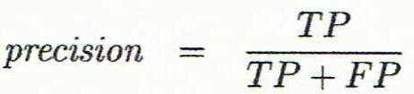
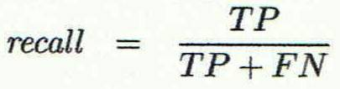
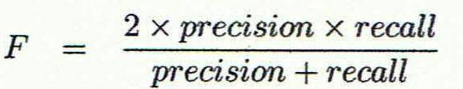
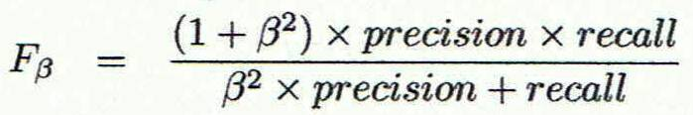
Classifier Evaluation Metrics: Precision and Recall, and F-measures
Precision: exactness – what % of tuples that the classifier labeled as positive are actually positive
Recall: completeness – what % of positive tuples did the classifier label as positive?
Perfect score is 1.0
Inverse relationship between precision & recall
F measure (F1 or F-score): harmonic mean of precision and recall,
Fß: weighted measure of precision and recall
assigns ß times as much weight to recall as to precision

Slide 69
Classifier Evaluation Metrics: Example
Actual Class\Predicted class | cancer = yes | cancer = no | Total | Recognition(%)
cancer = yes | 90 | 210 | 300 | 30.00 (sensitivity
cancer = no | 140 | 9560 | 9700 | 98.56 (specificity)
Total | 230 | 9770 | 10000 | 96.40 (accuracy)
Precision = 90/230 = 39.13% Recall = 90/300 = 30.00%

Slide 70
Evaluating Classifier Accuracy: Holdout & Cross-Validation Methods
Holdout method
Given data is randomly partitioned into two independent sets
Training set (e.g., 2/3) for model construction
Test set (e.g., 1/3) for accuracy estimation
Random sampling: a variation of holdout
Repeat holdout k times, accuracy = avg. of the accuracies obtained
Cross-validation (k-fold, where k = 10 is most popular)
Randomly partition the data into k mutually exclusive subsets, each approximately equal size
At i-th iteration, use D_{i} as test set and others as training set
Leave-one-out: k folds where k = # of tuples, for small sized data
*Stratified cross-validation*: folds are stratified so that class dist. in each fold is approx. the same as that in the initial data

Slide 71

Evaluating Classifier Accuracy: Bootstrap
Bootstrap
Works well with small data sets
Samples the given training tuples uniformly with replacement, i.e., each time a tuple is selected, it is equally likely to be selected again and re-added to the training set
Several bootstrap methods, and a common one is .632 boostrap
A data set with d tuples is sampled d times, with replacement, resulting in a training set of d samples
The data tuples that did not make it into the training set end up forming the test set. About 63.2% of the original data end up in the bootstrap, and the remaining 36.8% form the test set (since (1 – 1/d)^{d} ≈ e⁻¹ = 0.368)
Repeat the sampling procedure k times, overall accuracy of the model:

Slide 72


Estimating Confidence Intervals: Classifier Models M₁ vs. M₂
Suppose we have two classifiers, M₁ and M₂, which one is better?
Use 10-fold cross-validation to obtain and
These mean error rates are just estimates of error on the true population of future data cases
What if the difference between the two error rates is just attributed to chance?
Use a test of statistical significance
Obtain confidence limits for our error estimates

Slide 73
Estimating Confidence Intervals: Null Hypothesis
Perform 10-fold cross-validation
Assume samples follow a t distribution with k–1 degrees of freedom (here, k=10)
Use t-test (or Student’s t-test)
Null Hypothesis: M₁ & M₂ are the same
If we can reject null hypothesis, then
we conclude that the difference between M₁ & M₂ is statistically significant
Chose model with lower error rate

Slide 74
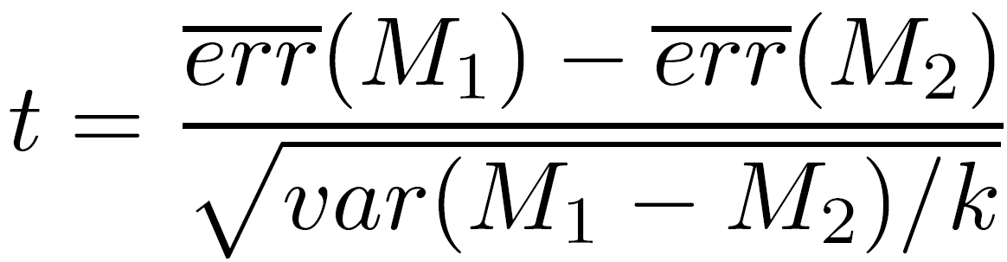
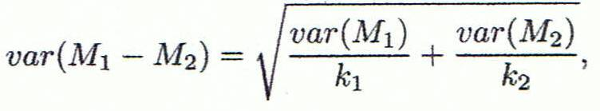
Estimating Confidence Intervals: t-test
If only 1 test set available: pairwise comparison
For i^{th} round of 10-fold cross-validation, the same cross partitioning is used to obtain err(M₁)_{i} and err(M₂)_{i}
Average over 10 rounds to get
t-test computes t-statistic with k-1 degrees of freedom:
If two test sets available: use non-paired t-test
where
where
where k₁ & k₂ are # of cross-validation samples used for M₁ & M₂, resp.

Slide 75
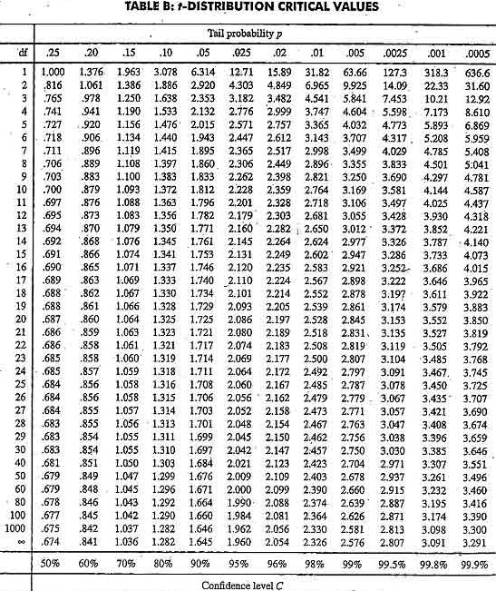
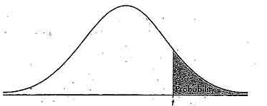
Estimating Confidence Intervals: Table for t-distribution
Symmetric
Significance level, e.g., sig = 0.05 or 5% means M₁ & M₂ are significantly different for 95% of population
Confidence limit, z = sig/2

Slide 76
Estimating Confidence Intervals: Statistical Significance
Are M₁ & M₂ significantly different?
Compute t. Select significance level (e.g. sig = 5%)
Consult table for t-distribution: Find t value corresponding to k-1 degrees of freedom (here, 9)
t-distribution is symmetric: typically upper % points of distribution shown → look up value for confidence limit z=sig/2 (here, 0.025)
If t > z or t < -z, then t value lies in rejection region:
Reject null hypothesis that mean error rates of M₁ & M₂ are same
Conclude: statistically significant difference between M₁ & M₂
Otherwise, conclude that any difference is chance

Slide 77
Model Selection: ROC Curves
ROC (Receiver Operating Characteristics) curves: for visual comparison of classification models
Originated from signal detection theory
Shows the trade-off between the true positive rate and the false positive rate
The area under the ROC curve is a measure of the accuracy of the model
Rank the test tuples in decreasing order: the one that is most likely to belong to the positive class appears at the top of the list
The closer to the diagonal line (i.e., the closer the area is to 0.5), the less accurate is the model
Vertical axis represents the true positive rate
Horizontal axis rep. the false positive rate
The plot also shows a diagonal line
A model with perfect accuracy will have an area of 1.0

Slide 78
Issues Affecting Model Selection
Accuracy
classifier accuracy: predicting class label
Speed
time to construct the model (training time)
time to use the model (classification/prediction time)
Robustness: handling noise and missing values
Scalability: efficiency in disk-resident databases
Interpretability
understanding and insight provided by the model
Other measures, e.g., goodness of rules, such as decision tree size or compactness of classification rules

Slide 79
4.5 Techniques to Improve Classification Accuracy: Ensemble Methods

Slide 80
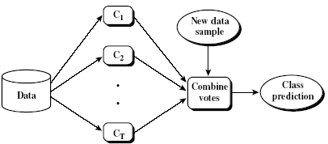
Ensemble Methods: Increasing the Accuracy
Ensemble methods
Use a combination of models to increase accuracy
Combine a series of k learned models, M1, M2, …, Mk, with the aim of creating an improved model M*
Popular ensemble methods
Bagging: averaging the prediction over a collection of classifiers
Boosting: weighted vote with a collection of classifiers
Ensemble: combining a set of heterogeneous classifiers

Slide 81
Bagging: Boostrap Aggregation
Analogy: Diagnosis based on multiple doctors’ majority vote
Training
Given a set D of d tuples, at each iteration i, a training set D_{i} of d tuples is sampled with replacement from D (i.e., bootstrap)
A classifier model M_{i} is learned for each training set D_{i}
Classification: classify an unknown sample X
Each classifier M_{i} returns its class prediction
The bagged classifier M* counts the votes and assigns the class with the most votes to X
Prediction: can be applied to the prediction of continuous values by taking the average value of each prediction for a given test tuple
Accuracy
Often significantly better than a single classifier derived from D
For noise data: not considerably worse, more robust
Proved improved accuracy in prediction

Slide 82
Boosting
Analogy: Consult several doctors, based on a combination of weighted diagnoses—weight assigned based on the previous diagnosis accuracy
How boosting works?
Weights are assigned to each training tuple
A series of k classifiers is iteratively learned
After a classifier M_{i} is learned, the weights are updated to allow the subsequent classifier, M_{i+1}, to pay more attention to the training tuples that were misclassified by M_{i}
The final M* combines the votes of each individual classifier, where the weight of each classifier's vote is a function of its accuracy
Boosting algorithm can be extended for numeric prediction
Comparing with bagging: Boosting tends to have greater accuracy, but it also risks overfitting the model to misclassified data

Slide 83
Adaboost (Freund and Schapire, 1997)
Given a set of d class-labeled tuples, (X₁, y₁), …, (X_{d}, y_{d})
Initially, all the weights of tuples are set the same (1/d)
Generate k classifiers in k rounds. At round i,
Tuples from D are sampled (with replacement) to form a training set D_{i} of the same size
Each tuple’s chance of being selected is based on its weight
A classification model M_{i} is derived from D_{i}
Its error rate is calculated using D_{i} as a test set
If a tuple is misclassified, its weight is increased, o.w. it is decreased
Error rate: err(X_{j}) is the misclassification error of tuple X_{j}. Classifier M_{i} error rate is the sum of the weights of the misclassified tuples:
The weight of classifier M_{i}’s vote is

Slide 84
Random Forest (Breiman 2001)
Random Forest:
Each classifier in the ensemble is a decision tree classifier and is generated using a random selection of attributes at each node to determine the split
During classification, each tree votes and the most popular class is returned
Two Methods to construct Random Forest:
Forest-RI (random input selection): Randomly select, at each node, F attributes as candidates for the split at the node. The CART methodology is used to grow the trees to maximum size
Forest-RC (random linear combinations): Creates new attributes (or features) that are a linear combination of the existing attributes (reduces the correlation between individual classifiers)
Comparable in accuracy to Adaboost, but more robust to errors and outliers
Insensitive to the number of attributes selected for consideration at each split, and faster than bagging or boosting

Slide 85
Classification of Class-Imbalanced Data Sets
Class-imbalance problem: Rare positive example but numerous negative ones, e.g., medical diagnosis, fraud, oil-spill, fault, etc.
Traditional methods assume a balanced distribution of classes and equal error costs: not suitable for class-imbalanced data
Typical methods for imbalance data in 2-class classification:
Oversampling: re-sampling of data from positive class
Under-sampling: randomly eliminate tuples from negative class
Threshold-moving: moves the decision threshold, t, so that the rare class tuples are easier to classify, and hence, less chance of costly false negative errors
Ensemble techniques: Ensemble multiple classifiers introduced above
Still difficult for class imbalance problem on multiclass tasks

Slide 86
Rangkuman
Classification is a form of data analysis that extracts models describing important data classes
Effective and scalable methods have been developed for decision tree induction, Naive Bayesian classification, rule-based classification, and many other classification methods
Evaluation metrics include: accuracy, sensitivity, specificity, precision, recall, F measure, and Fß measure
Stratified k-fold cross-validation is recommended for accuracy estimation. Bagging and boosting can be used to increase overall accuracy by learning and combining a series of individual models

Slide 87
Rangkuman
Significance tests and ROC curves are useful for model selection.
There have been numerous comparisons of the different classification methods; the matter remains a research topic
No single method has been found to be superior over all others for all data sets
Issues such as accuracy, training time, robustness, scalability, and interpretability must be considered and can involve trade-offs, further complicating the quest for an overall superior method

Slide 88
Ujian
Pahami soal ujian dengan baik dan runut
Download dataset di: http://romisatriawahono.net/lecture/dm/exam/

Slide 89
Referensi
Jiawei Han and Micheline Kamber, Data Mining: Concepts and Techniques Third Edition, Elsevier, 2012
Ian H. Witten, Frank Eibe, Mark A. Hall, Data mining: Practical Machine Learning Tools and Techniques 3rd Edition, Elsevier, 2011
Markus Hofmann and Ralf Klinkenberg, RapidMiner: Data Mining Use Cases and Business Analytics Applications, CRC Press Taylor & Francis Group, 2014
Daniel T. Larose, Discovering Knowledge in Data: an Introduction to Data Mining, John Wiley & Sons, 2005
Ethem Alpaydin, Introduction to Machine Learning, 3rd ed., MIT Press, 2014
Florin Gorunescu, Data Mining: Concepts, Models and Techniques, Springer, 2011
Oded Maimon and Lior Rokach, Data Mining and Knowledge Discovery Handbook Second Edition, Springer, 2010
Warren Liao and Evangelos Triantaphyllou (eds.), Recent Advances in Data Mining of Enterprise Data: Algorithms and Applications, World Scientific, 2007

